Slide 1
HireAC
YOUR HOW TO GUIDE

Slide 2
HireAC Guide Sections
Getting Started with HireAC
Cooperative Education Module in HireAC
Changing Preferred Name in HireAC
Downloading the Co-op Work Permit Confirmation Letter
Co-op Documents Page in HireAC
Co-op Job Postings Page in HireAC
Setting up Job Alerts in HireAC
Co-op Interviews Page in HireAC
Co-op Job Offers in HireAC
Co-op Work-term record in HireAC
Booking a Peer Review meeting in HireAC
Events And Workshops Module in HireAC
Career & Employment Module in HireAC

Slide 3
7. Setting up Job Alerts in HireAC
Be notified as soon as a job is posted for your program!

Slide 4
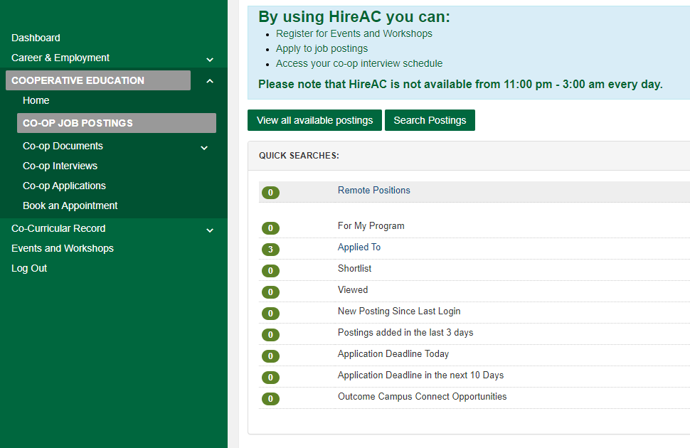
Search Postings in HireAC
Go to HireAC, Cooperative Education module
Click on the Co-op Job Posting tab
Select Search Postings
1
3
2

Slide 5
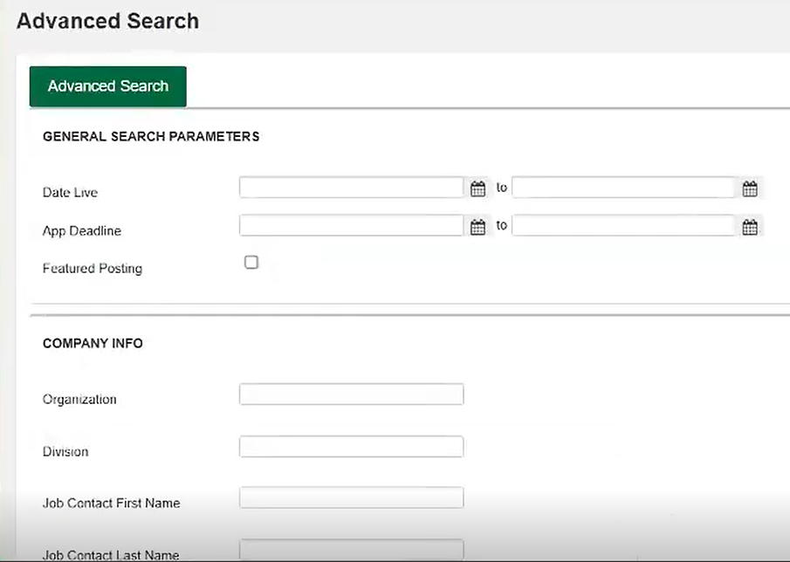
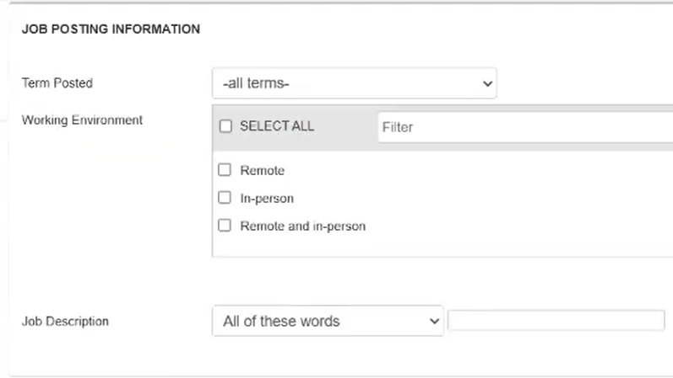
Using the Advanced Search option
This will bring you to the Advanced Search option. Search jobs using various options available in the form.
Company Info: Search jobs posted by a specific employer. E.g. Canada Revenue Agency
Job Posting Information: Use keywords to search for jobs that align with the skills you want to develop. Alternatively, select your scheduled Co-op work term under 'Term Posted' to set up notifications for all newly posted opportunities.
Click Advanced Search this will bring up all the jobs that fit your criteria.
1
5

Slide 6
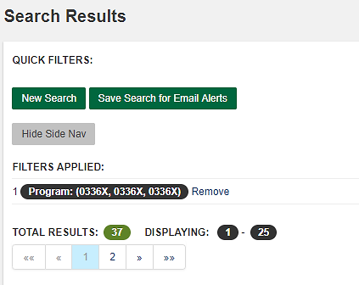
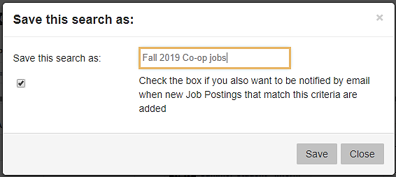
Set Up Automatic Email Alerts
On the top of the next page, click on Save Search for Email Alerts. This will bring a pop-up box, and it will prompt you to name your search.
Use as much description as possible to help you remember what your search result is
E.g.: Winter 2026 Co-op jobs
In addition, check the box to receive an email when jobs that match your criteria are added to HireAC, and press Save. Email alerts about new jobs will be sent to your Algonquin Live email.
Note: You can set up multiple job alerts in your Co-op record to reflect the variety of roles that interest you.
1
1
2
3
6

